Slide 1

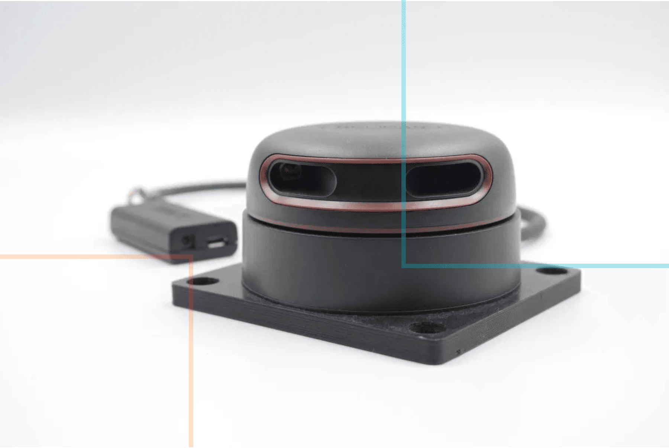
Distance Sensing and Occupancy Grid Mapping
AI and Robotics
Building environmental maps from LiDAR sensor data

Slide 2

Today's Agenda
01
Distance Sensing Technologies
Compare LiDAR, ultrasonic, and infrared sensors for robot perception
02
LiDAR and Point Clouds
Understand how LiDAR works and represents environmental data
03
Occupancy Grid Representation
Learn probabilistic grid maps and log-odds representation
04
Mapping Algorithm
Implement inverse sensor model and ray casting for grid updates
05
Real-World Applications
Explore applications in warehouses, autonomous vehicles, and beyond
06
This Week's Lab Preview
Build your own occupancy grid mapping system

Slide 3

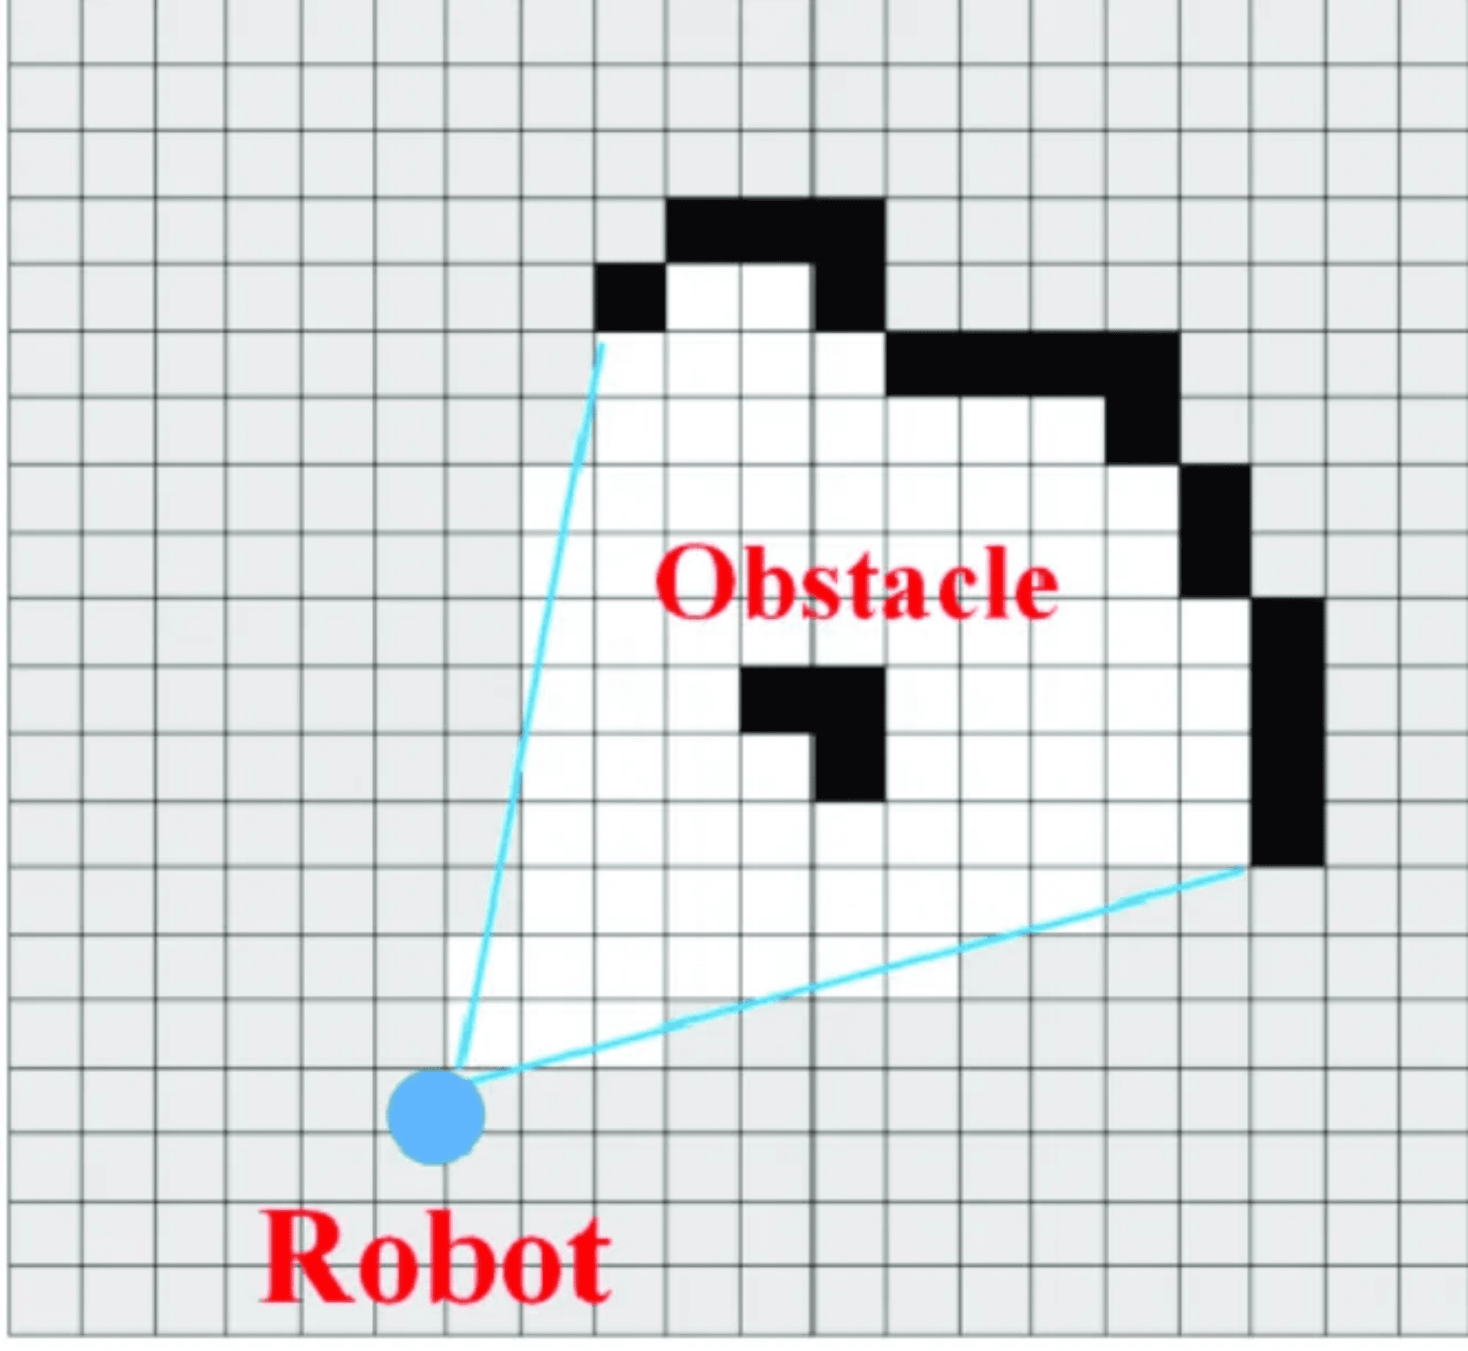
Why Mapping Matters for Autonomous Robots
Week 3: We learned how robots answer "Where am I?" using Kalman filtering for localization.
Week 4: Now we tackle "What's around me?" by building maps from sensor data.
Localization + Mapping = Autonomous Navigation
Real-World Example: A warehouse robot must know obstacle locations to plan safe paths for package delivery.
The Challenge: Build accurate, reliable maps from noisy sensor measurements in real-time.
Example occupancy grid map showing obstacles (black), free space (white), and unknown areas (gray)

Slide 4

Distance Sensing Technologies: Three Main Types
Robots use different sensors depending on application requirements
Characteristic
Ultrasonic
Infrared (IR)
LiDAR
Technology
Sound waves (40 kHz)
Infrared light reflection
Laser pulses (TOF)
Range
2 cm – 4 m
10 cm – 80 cm
0.1 m – 100+ m
Accuracy
±1-3 cm
±2-5 cm
±2-5 cm (long range)
±1 mm (short range)
Update Rate
≤50 Hz
100+ Hz
5-40 Hz (360° scan)
Cost
$1-5
$2-10
$100-$10,000+
Key Advantage
Cheap, simple, robust
Fast, compact
Accurate, 360° coverage
Key Limitation
Slow, wide beam angle
Lighting sensitive, short range
Expensive, complex
Typical Use
Parking sensors, low-cost robots
Line following, proximity
Mapping, autonomous vehicles
Note: Robots often use multiple sensor types for sensor fusion (complementary strengths)

Slide 5

Ultrasonic Sensors: Low-Cost Distance Measurement
TECHNOLOGY
Advantages
Sound waves at 40 kHz (above human hearing)
Very low cost and simple to use
•
RANGE
Works in various lighting conditions (day/night)
•
2 cm to 4 meters (typical)
Not affected by object color or transparency
•
ACCURACY
Robust to dust and smoke
•
±1-3 cm
Disadvantages
UPDATE RATE
Slow update rate (limited by speed of sound)
Up to 50 Hz (20 ms per measurement)
•
Wide beam angle (~15°) reduces precision
•
COST
Affected by soft materials (curtains, foam)
$1-5 per sensor
•
Temperature dependent (speed of sound varies)
•
EXAMPLE
HC-SR04 (Arduino), MaxBotix sensors
Applications
Car parking sensors
•
Low-cost mobile robots
•
Obstacle detection for Arduino projects
•

Slide 6

Infrared Sensors: Fast but Limited Range
TECHNOLOGY
Advantages
Infrared light reflection (IR LED + photodiode)
Very fast update rate (100+ Hz)
•
RANGE
Low cost and compact size
•
10 cm to 80 cm (typical)
Simple analog output (voltage proportional to distance)
•
ACCURACY
Good for close-range detection
•
±2-5 cm
Disadvantages
UPDATE RATE
Affected by ambient light (sunlight, IR sources)
100+ Hz (very fast)
•
Surface color and texture affect readings
•
COST
Limited range (typically <1 meter)
$2-10 per sensor
•
Nonlinear response curve (requires calibration)
•
EXAMPLE
Sharp GP2Y0A21YK, Pololu distance sensors
Applications
Line-following robots
•
Cliff detection (vacuum cleaners)
•
Proximity sensing for user interfaces
•
Short-range obstacle avoidance
•

Slide 7
LiDAR: Industry Standard for Robot Mapping
TECHNOLOGY
Advantages
Laser pulses (infrared or visible light)
High accuracy and long range
•
RANGE
360° coverage in single scan
•
0.1 m to 100+ meters (model dependent)
Not affected by lighting conditions
•
ACCURACY
Dense point clouds for detailed mapping
•
±2-5 cm at long range, ±1 mm at short range
Disadvantages
UPDATE RATE
Expensive (especially high-end models)
5-40 Hz for full 360° scan
•
Complex data processing required
•
RESOLUTION
Struggles with transparent surfaces (glass, water)
360-1080 measurements per scan
•
Reflective surfaces cause false readings
•
COST
$100 (RPLiDAR) to $10,000+ (Velodyne)
Applications
EXAMPLES
Autonomous vehicles (Tesla, Waymo)
•
SICK LMS, Hokuyo URG, RPLiDAR, Velodyne
Warehouse robots (Amazon, Fetch)
•
Drones and UAVs
•
Surveying and 3D scanning
•

Slide 8

How LiDAR Measures Distance
1
Emit a laser pulse toward the environment
2
Measure time-of-flight (TOF): time for light to travel to object and return
3
Calculate distance using the speed of light
d = (c × t) / 2
where c = speed of light (3 × 108 m/s), t = time-of-flight
4
Rotate sensor to scan 360° around the robot
5
Result: Array of 360-1080 distance measurements at different angles

Slide 9

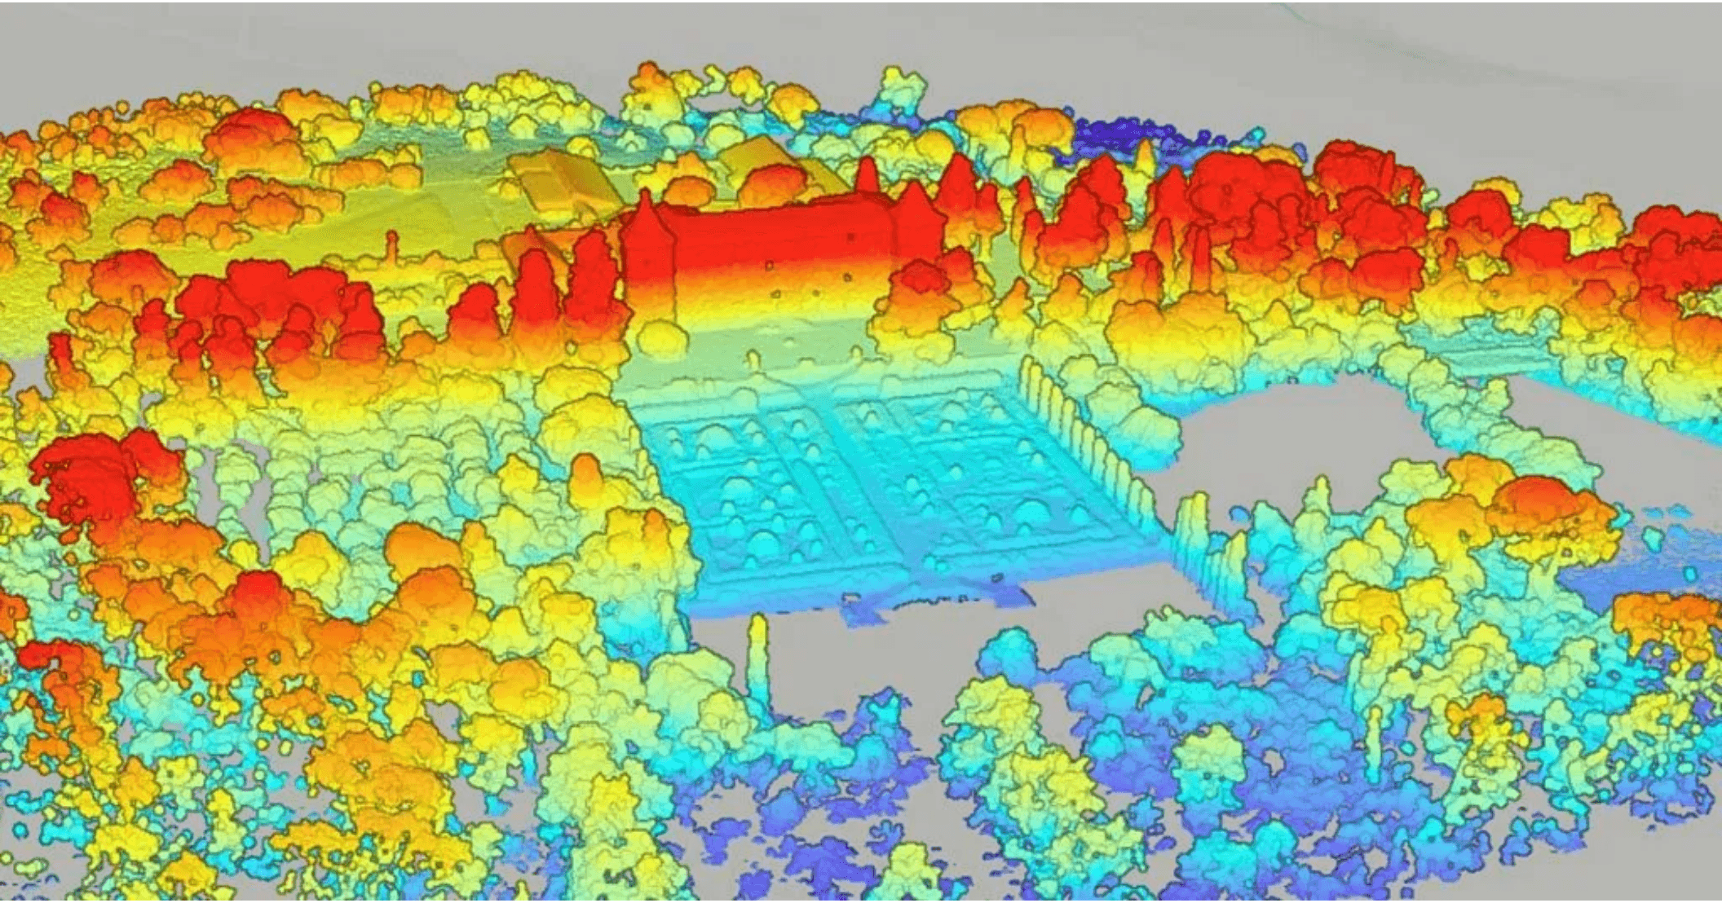
Point Cloud Representation of Environment
LiDAR Output: Array of (angle, distance) pairs for each measurement in a scan.
Conversion to Cartesian: Transform polar coordinates to (x, y) in robot frame:
x = d × cos(θ) y = d × sin(θ)
Point Cloud: Set of (x, y) points representing detected obstacles in the environment.
Visualization: Scatter plot where each point represents a surface the laser hit.
3D point cloud from LiDAR showing environmental structure
Challenge: How do we use this sparse point data for navigation and obstacle avoidance?

Slide 10

Coordinate Frame Transformations
Robot Frame
World Frame
Origin at robot center x-axis: forward y-axis: left LiDAR measurements in this frame
Fixed global coordinate system Independent of robot motion Map is built in this frame Persistent across time
Transformation: Robot → World
Given robot pose
(x
r
, y
r
, θ
r
)
in world frame:
xworld = xr + xrobot × cos(θr) − yrobot × sin(θr)
yworld = yr + xrobot × sin(θr) + yrobot × cos(θr)
Why Needed: To build a persistent map, we must transform LiDAR points from the moving robot frame to the fixed world frame at each robot pose.

Slide 11

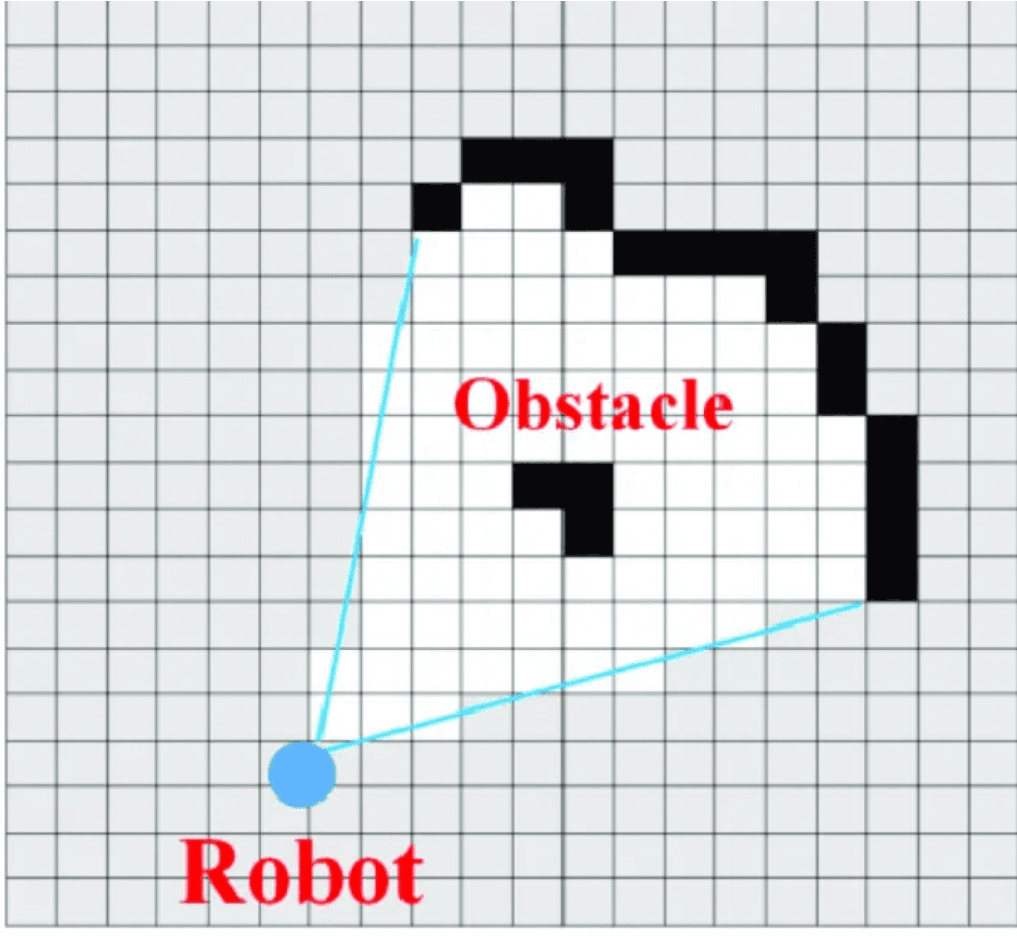
Occupancy Grid Maps: Discretizing the Environment
Core Idea: Discretize the continuous environment into a grid of cells (e.g., 10 cm × 10 cm).
Each Cell Stores: Probability that the cell is occupied: P(occupied)
Three States:
Occupied
P > 0.7 (obstacle present)
Free
P < 0.3 (no obstacle)
Unknown
0.3 ≤ P ≤ 0.7 (uncertain)
Advantages: Simple, efficient, handles uncertainty naturally
Used By: Vacuum cleaners (Roomba), warehouse robots, autonomous vehicles
Occupancy grid: Black = occupied, White = free, Gray = unknown

Slide 12

Grid Data Structure and Parameters
Implementation: 2D array where grid[x][y] stores the probability of cell (x, y) being occupied.
Resolution
Size
Size of each cell (e.g., 0.1 m = 10 cm) Trade-off: Higher resolution = more detail but more memory and computation
Width × Height in cells Example: 100 × 100 cells = 10m × 10m area Depends on environment size
Origin
Data Type
Where is grid[0][0] in world coordinates? Typically center or corner of the mapped environment
Float (4 bytes) for probability OR log-odds representation Can use int8 for memory efficiency

Slide 13
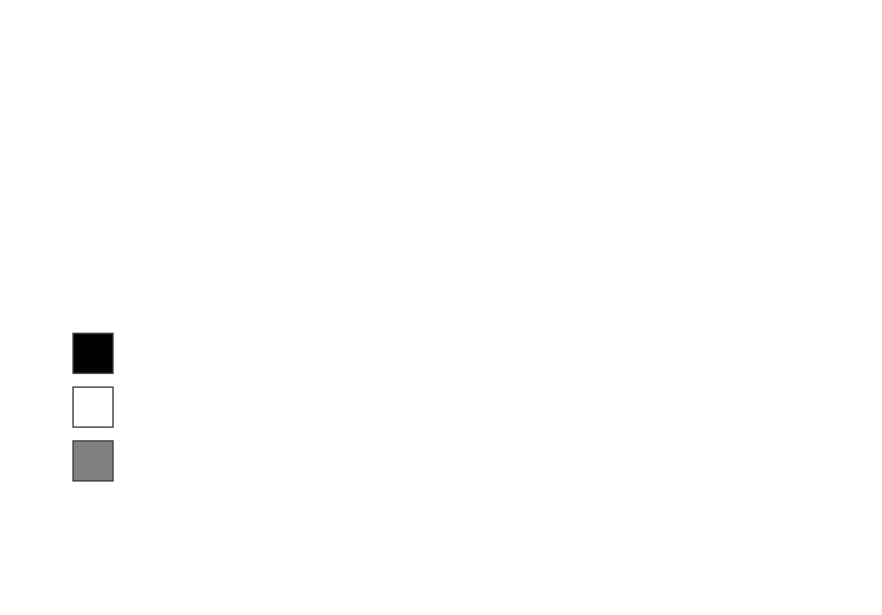
Grid Memory Requirements and Visualization
Memory Example:
100 × 100 grid × 1 byte per cell = 10,000 bytes = 10 KB 1000 × 1000 grid × 1 byte per cell = 1,000,000 bytes = 1 MB Even large environments remain memory-efficient!
Visualization as Grayscale Image
Black (P = 1.0): Occupied cell (obstacle present)
White (P = 0.0): Free cell (no obstacle)
Gray (P = 0.5): Unknown cell (not yet explored)
Implementation: Convert probability to grayscale value (0-255) and render as image for easy visualization and debugging.

Slide 14

Log-Odds: Efficient Probability Updates
Problem with Probabilities
Updating probabilities requires multiplication, which is slow and prone to numerical underflow when values approach 0 or 1.
Solution: Log-Odds Representation
L(x) = log(P(x) / (1 − P(x)))
Convert probability to log-odds, update using addition, convert back to probability when needed.
Advantages:
Addition instead of multiplication: Lnew = Lold + Lmeasurement
✓
Unbounded range: (−∞, +∞) instead of [0, 1]
✓
No numerical underflow: Stable for many updates
✓
Easy to convert back: P(x) = 1 / (1 + e−L(x))
✓

Slide 15

Inverse Sensor Model for LiDAR
Concept: Given a measurement, what is the probability that a cell is occupied? P(occupied | measurement)
For each LiDAR ray: Update all cells along the ray from robot to measured endpoint.
Update Rules:
1. Endpoint (Obstacle Hit)
Cell where laser hit an obstacle → Increase occupancy (e.g., P = 0.7 or L = +1.0)
2. Before Endpoint (Free Space)
Cells between robot and endpoint → Decrease occupancy (e.g., P = 0.3 or L = −1.0) Laser passed through, so these cells are free
3. After Endpoint (Unknown)
Cells beyond endpoint → No update Laser didn't reach these cells, so we have no information
Key Insight: A single measurement provides information about multiple cells (occupied endpoint + free space along ray).

Slide 16

Ray Casting: Finding Cells Along a Ray
Problem: Given start (robot) and end (measurement) points, which grid cells does the ray pass through?
Bresenham's Line Algorithm
Usage in Mapping
Classic algorithm from computer graphics for drawing lines on pixel grids Input: Start (x₀, y₀), End (x₁, y₁) Output: List of all grid cells along the line
1. Ray cast from robot to measurement endpoint 2. Mark all cells along ray as "free" 3. Mark endpoint cell as "occupied" 4. Repeat for all measurements in scan
Efficiency
Uses only integer arithmetic (addition, subtraction) No floating-point operations or trigonometry Very fast, suitable for real-time mapping
Implementation: Available in most robotics libraries (e.g., Python's scikit-image, ROS nav_msgs)

Slide 17

Occupancy Grid Update Algorithm
1
Get measurement: (angle, distance) from LiDAR scan
2
Convert to Cartesian: (x, y) = (d × cos(θ), d × sin(θ)) in robot frame
3
Transform to world frame: Apply robot pose (xr, yr, θr) transformation
4
Ray cast: Find all grid cells from robot position to measurement endpoint
5
Update cells: For each cell along ray: • Before endpoint: Lcell += Lfree (e.g., −1.0) • At endpoint: Lcell += Loccupied (e.g., +1.0)
6
Clamp values: Limit log-odds to prevent overflow (e.g., [−10, +10])
7
Repeat: Process all measurements in scan, then all scans over time
Result: Occupancy grid map showing obstacles, free space, and unknown areas

Slide 18

Mapping with Known Robot Poses
Key Assumption: We assume the robot's pose (x, y, θ) is known at each time step from localization (Week 3: Kalman filtering).
Input
Process
• Sequence of robot poses • LiDAR scans at each pose • Sensor parameters (noise, range)
1. Initialize empty grid (all unknown) 2. For each (pose, scan) pair: • Transform measurements to world frame • Update grid using inverse sensor model 3. Result: Map showing obstacles and free space
Output
• Occupancy grid map • Black: obstacles • White: free space • Gray: unknown
Next Week: What if poses are unknown? → SLAM (Simultaneous Localization and Mapping)

Slide 19

Example: Progressive Map Building
As the robot collects more scans, the map becomes more confident and detailed:
Initial (1 scan)
Mature (50+ scans)
• Mostly unknown (gray) • Single ray pattern visible • Low confidence in all cells • Sparse obstacle detection
• Clear obstacle boundaries • Well-defined free space • High confidence (sharp black/white) • Unknown areas only where not explored
Early (10 scans)
Key Insight
• Obstacle outlines emerging • Free space corridors visible • Still some uncertainty • Repeated observations increase confidence
More data = more confidence Log-odds accumulate evidence over time, making the map increasingly reliable for navigation

Slide 20

Real-World Applications of Occupancy Grids
Warehouse Robots
Vacuum Cleaners
Amazon, Fetch Robotics: Navigate warehouses, avoid obstacles, plan paths for package delivery
Roomba, Roborock: Build floor plans, ensure complete coverage, avoid stairs and obstacles
Autonomous Vehicles
Drones and UAVs
Tesla, Waymo: Local obstacle detection, parking assistance, low-speed maneuvering
Indoor navigation, 3D mapping, inspection tasks in GPS-denied environments
Agriculture
Search and Rescue
Autonomous tractors and harvesters navigate fields, avoid crops and obstacles
Robots explore disaster zones, build maps for first responders, locate survivors
Common Theme: Any robot that needs to navigate and avoid obstacles uses some form of occupancy grid mapping

Slide 21

Limitations and Challenges
Dynamic Environments
Loop Closure Drift
Moving objects (people, vehicles) cause false obstacles. Need temporal filtering or object tracking.
Pose errors accumulate over time. When robot returns to start, map may not align (requires SLAM).
Transparent/Reflective Surfaces
2D vs 3D Limitation
Glass, mirrors, water cause false readings. LiDAR beams pass through or reflect incorrectly.
2D grids miss overhangs, low obstacles. 3D voxel grids solve this but require much more memory.
Computational Cost
Resolution Trade-off
Large grids (1000×1000) with high update rates require significant processing power.
Fine resolution = more detail but more memory/computation. Coarse resolution = less accurate.
Despite limitations, occupancy grids remain the most widely used mapping representation in robotics

Slide 22

Beyond Occupancy Grids
Advanced mapping representations for specific applications:
3D Voxel Grids & Octrees
Topological Maps
3D extension of occupancy grids. Octrees provide hierarchical compression for efficient 3D mapping.
Graph of locations and connections. Compact representation for large environments, used in navigation.
Feature-Based Maps
Store landmarks (corners, edges) instead of grids. Used in visual SLAM, more memory-efficient.
Hybrid Approaches
Combine multiple representations (e.g., local occupancy grid + global topological map) for best of both worlds.
Semantic Maps
Label objects (chair, table, door) using deep learning. Enables high-level reasoning and task planning.
Neural Implicit Maps
Emerging: Use neural networks to represent maps continuously. Compact, smooth, but computationally expensive.

Slide 23

This Week's Lab: Build Your Own Occupancy Grid
Activity 1: Visualize LiDAR Data
Load simulated LiDAR scans, convert to Cartesian, visualize as point cloud
Activity 2: Basic Occupancy Grid
Implement grid data structure, mark occupied cells, visualize as grayscale image
Activity 3: Full Mapping with Ray Casting
Implement Bresenham ray casting, update with log-odds, build complete map
Deliverables:
Details:
• Python code (3 activities) • Visualizations (plots, maps) • Analysis answers
Time: 2-3 hours Tools: Python, NumPy, Matplotlib Data: Provided LiDAR scans

Slide 24
Key Takeaways
LiDAR is the industry standard for robot mapping: accurate, 360° coverage, works in all lighting
✓
Occupancy grids discretize the environment into cells storing probability of occupancy
✓
Log-odds representation enables efficient updates using addition instead of multiplication
✓
Inverse sensor model updates multiple cells per measurement (occupied endpoint + free space along ray)
✓
Ray casting (Bresenham) identifies cells along a ray for marking free space
✓
Known poses assumption: This week assumes robot pose is known from localization (Week 3)
✓
Limitations: Dynamic environments, transparent surfaces, 2D vs 3D, computational cost
✓

Slide 25

Questions?
Let's discuss distance sensing and occupancy grid mapping
Next Week: Path Planning and Navigation
Now that we can localize and map, how do we plan paths to navigate from A to B?

